Slide 1


www.wishgenie.in
“Live life of your dreams”

Slide 2
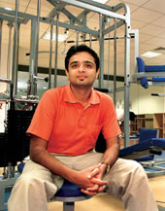

An example
Loves traveling ,cooking , beer n to stay fit.

Slide 3


Hotels
Hotel H1
OnSeason OffSeason
Rs 500/- Rs 500/-
Bid for it!
Rs 465/-(Reject)
Hotel H2
Rs 600/- Rs 550/-
Rs 465/- (Accept)
Earlier loss 600/-
Now profit 465/- Hence total gain 1065/-

Slide 4
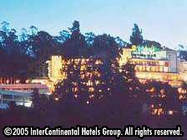

Holiday Inn GEM PARK-OOTY
“The idea for off-season by www.wishgenie.in not only enhances the promotion but also makes up for the losses.”

Slide 5

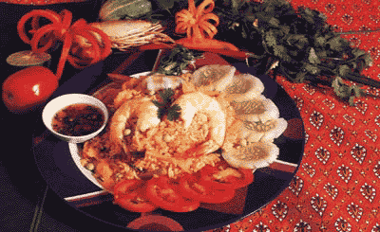
Food Health
Recipe Forum.
Consulting for recipes.
In Various Languages and Videos
Physiotherapists consulting for exercises.
Camps for keeping you fit.

Slide 6

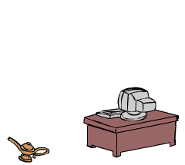
Instructors assisting you
Dr. Sudha Agarwal
Dr. Rajiv Saxena
Dr Shweta Sethi
Dr Tanvi Kapoor
Dr Kavit Sahani
Dr Majeed Jafari

Slide 7

What doctors say??
“Consulting has now becoming a part of life and I would be glad to consult for www.wishgenie.in as it involves meeting new people and a duty towards mankind.”
        Shweta Sethi (Physiotherapist Sancheti Pune)

Slide 8
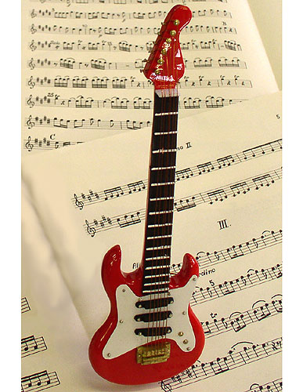
Music n Entertainment
Bands meet their sponsors
Customers can download free music.
Various Discussion Forums
and Consultants.
Download and Upload Music Sheets

Slide 9

Friend Finder
Most dating sites are
US based.
Passes cost around
Rs 850/-.
www.wishgenie.in operates only in India and neighboring countries.
Minimum charge of Rs 75/-

Slide 10

Plan Schedule
HealthCare
Abhinav Meherotra
Abhishek PM
Abhinav Garg
Abhijeet
Hotels
Dinesh S
Sougato
Karthikeyan
Anil
Friend Finder
Deepak Panigrahy
Balaji V
Debdeeb
Abhishek Dutta Gupta
Music n Entertainment
Shashank Handa
Sanjeev
Amit Meherotra
Amit Gangwar

Slide 11

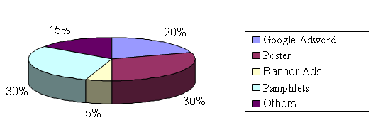
Promotion Plans

Slide 12
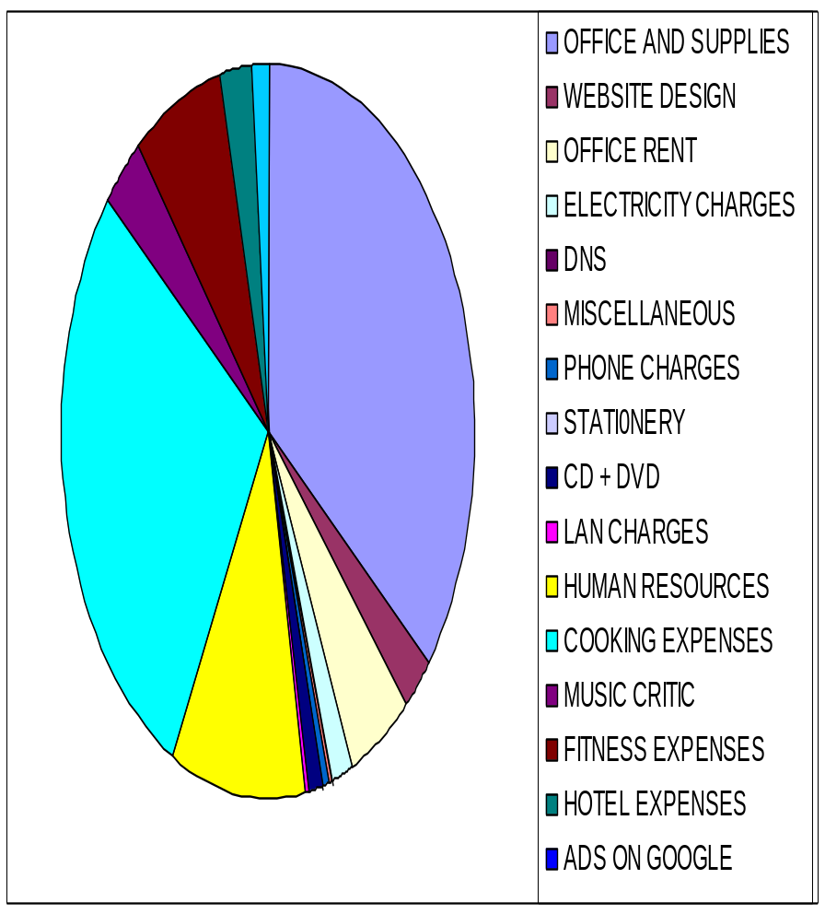
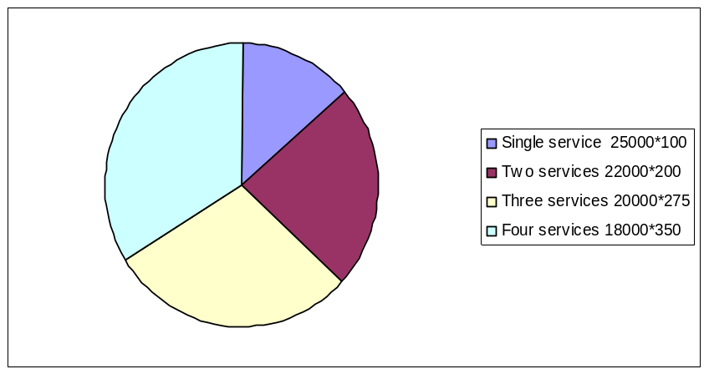
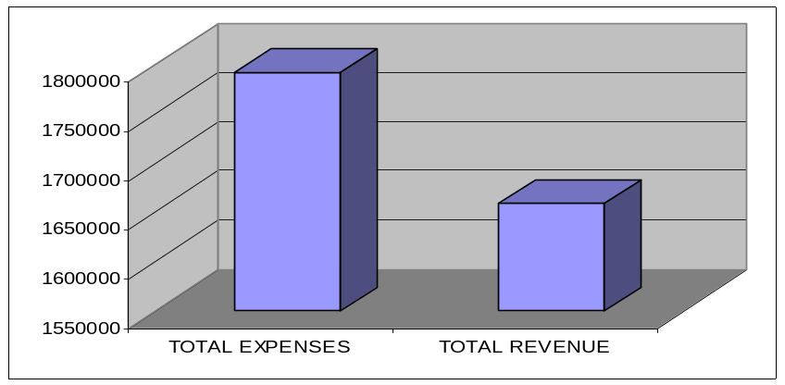
Introduction
Expense
Income
Expense Vs Income

Slide 13
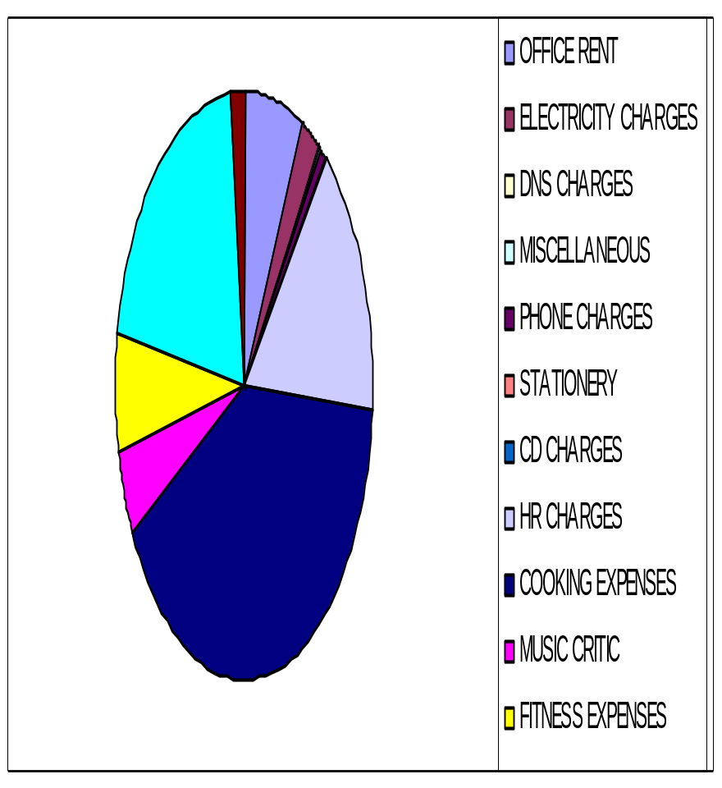
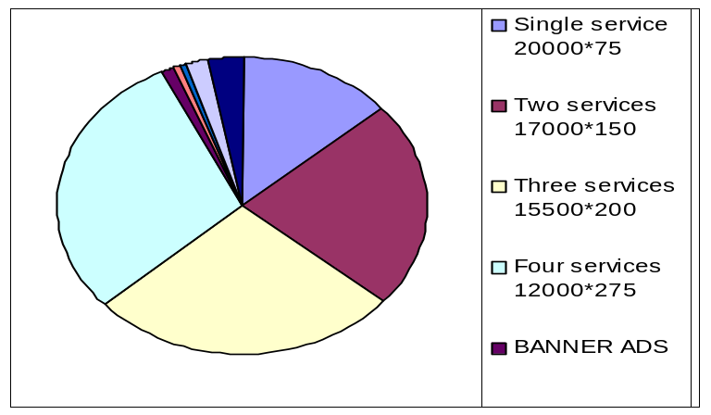
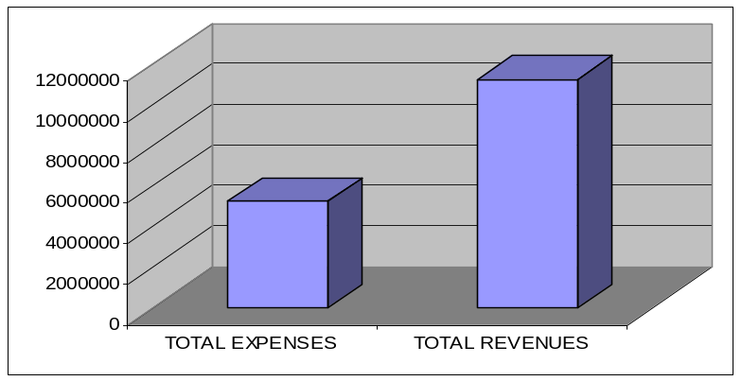
Growth
Expense
Income
Expense Vs Income

Slide 14
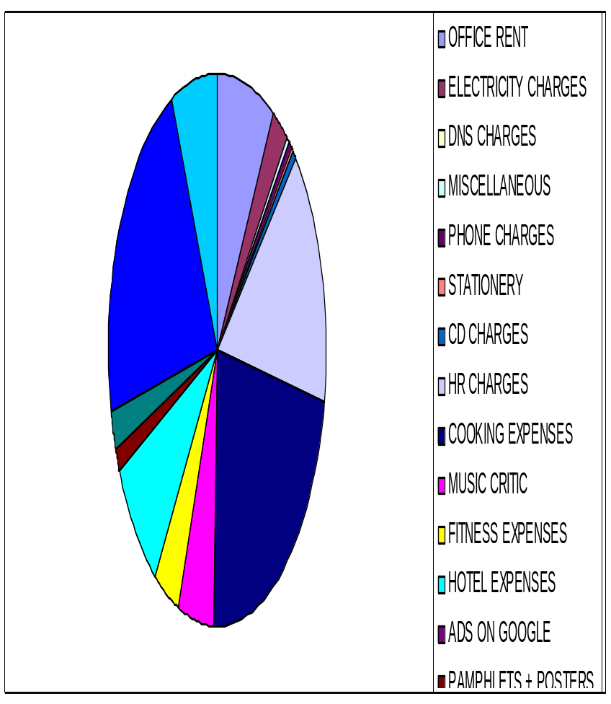
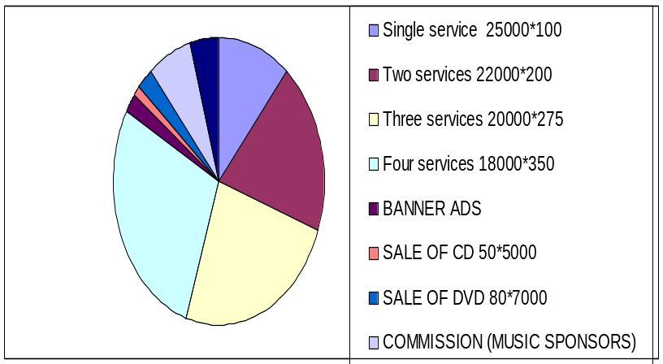
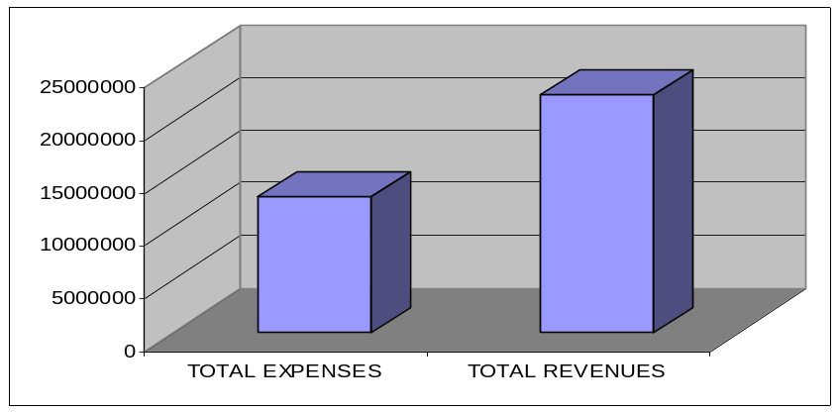
Maturity
Expense
Income
Expense Vs Income

Slide 15
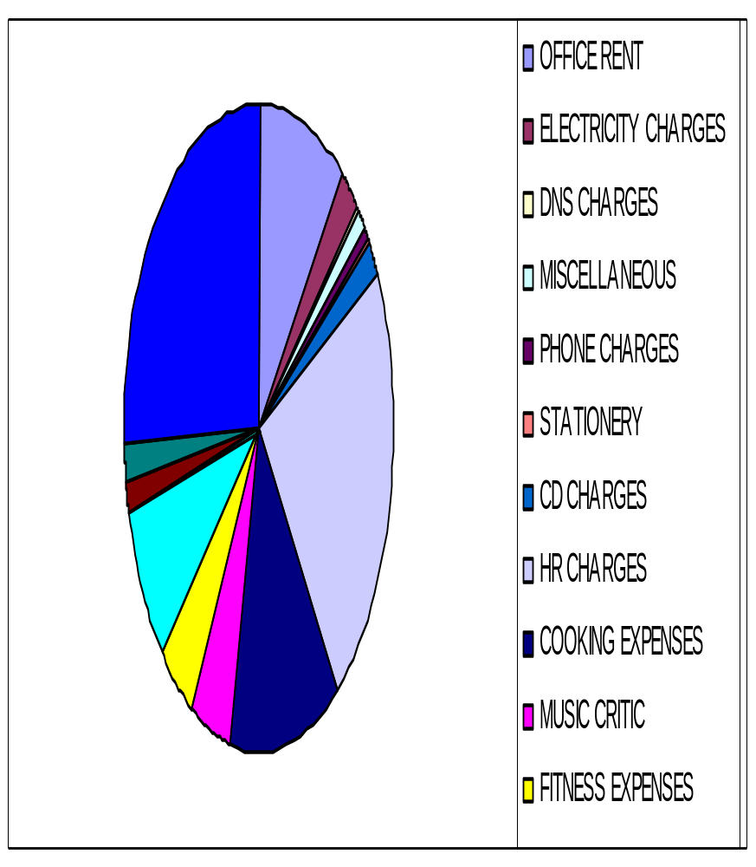
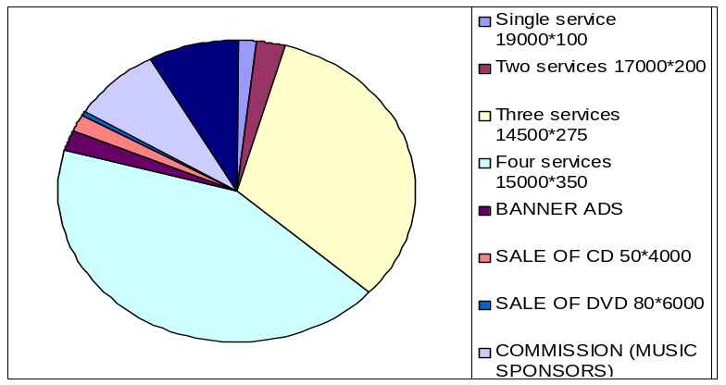
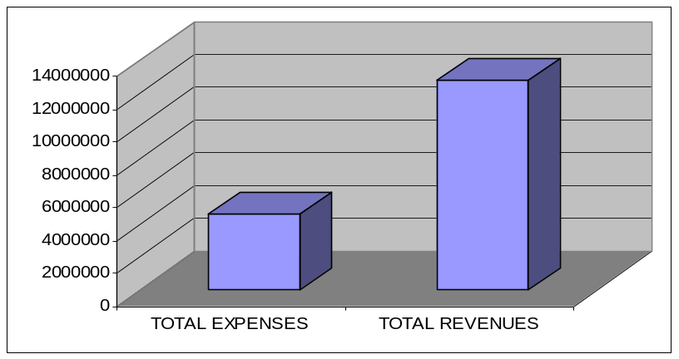
Decline
Expense
Income
Expense Vs Income

Slide 16
Projected PLC
Projected PLC of WishGenie.in
12000000
maturity
decline
10000000
8000000
6000000
4000000
growth
Profit/Loss in Rupees
2000000
0
Introductory
-2000000
0
2
4
6
8
10
Time Period in Years

Slide 17



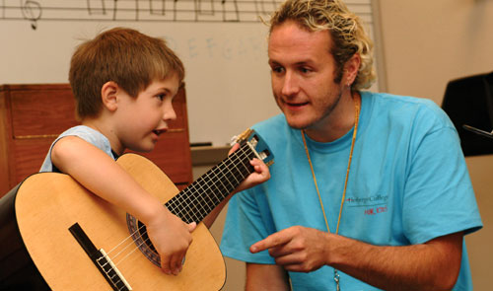
Clustered Segmentation

Slide 18

Questions

